Slide 1
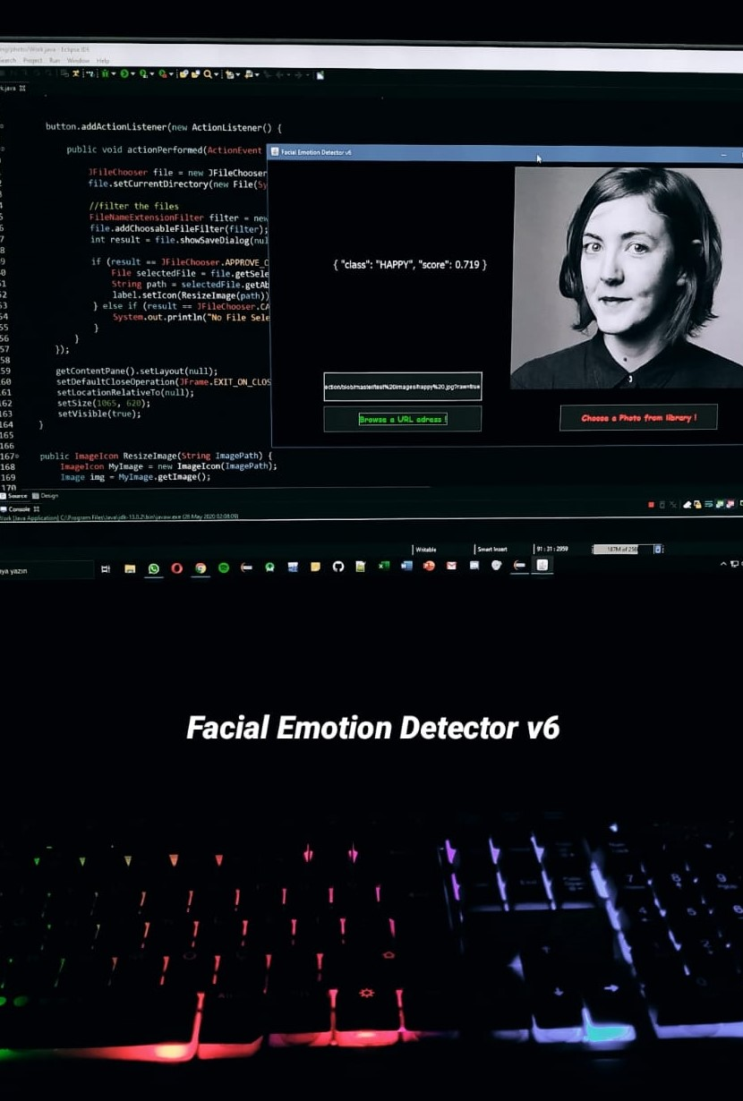
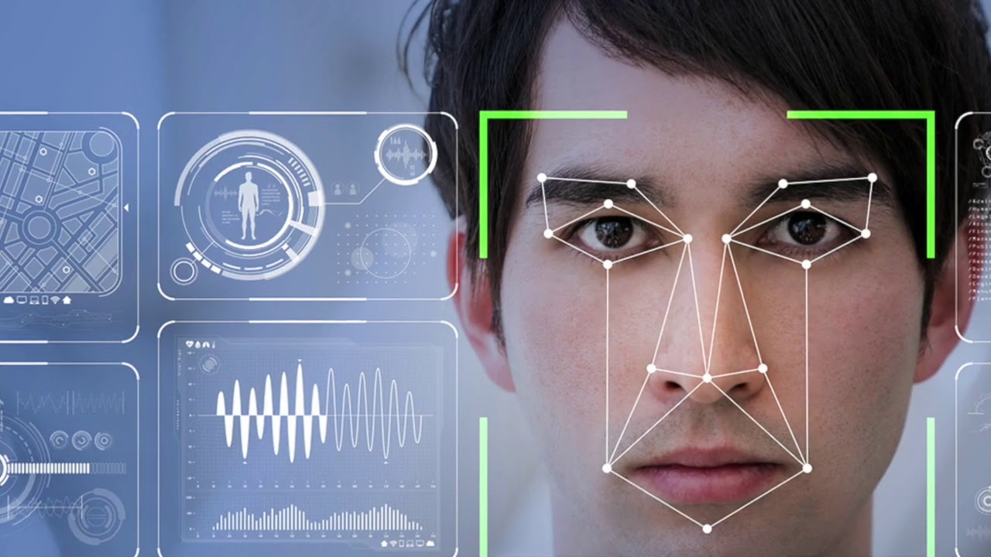

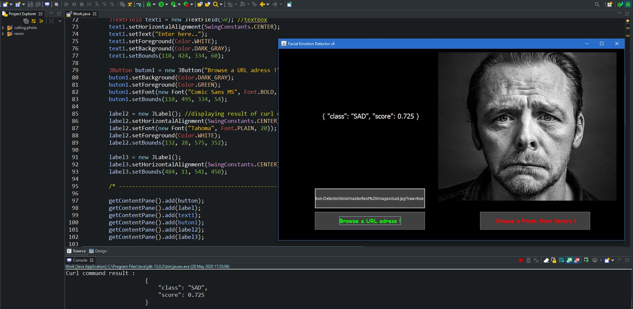
Engineering Project – Final Report Facial Emotion Detector v6
MERT ALTUNTAŞ - 1804010005

Slide 2
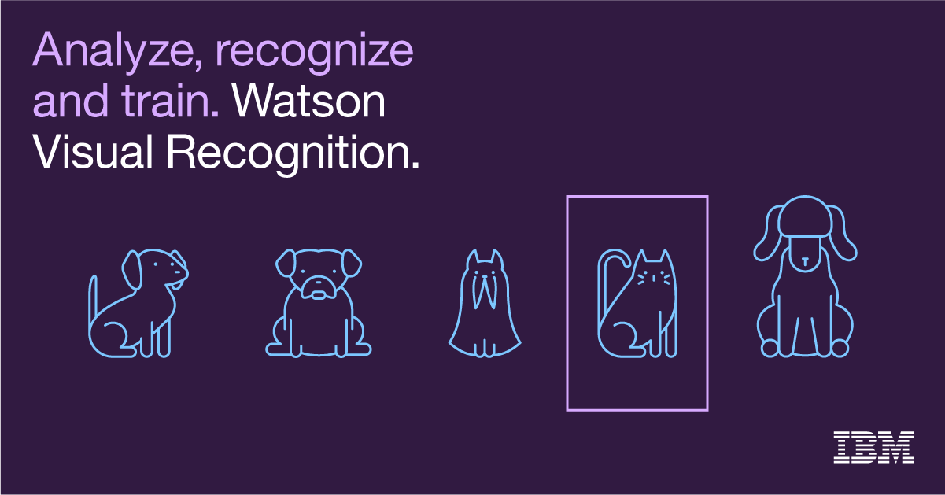

About Project
This Project aims detecting facial emotions of people and in additional, recognizing other objects except people.
In general this Project based on Convolutional Neural Networks.

Slide 3
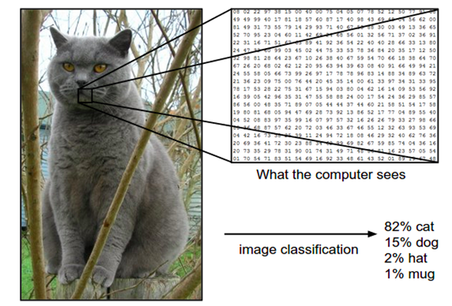
Convolutional Neural Networks
The idea of a Convolutional Neural Networks (CNNs) model was firstly applied to recognize a picture automatically.
A picture can be transformed into a matrix. Then a convolution operation is processed by simply sums up each cell product with weight within a window size. This window size scans from two directions (left to right, and from top and down).
IBM Watson services can do these process for us. So I used IBM Watson in the beginning of the project.

Slide 4

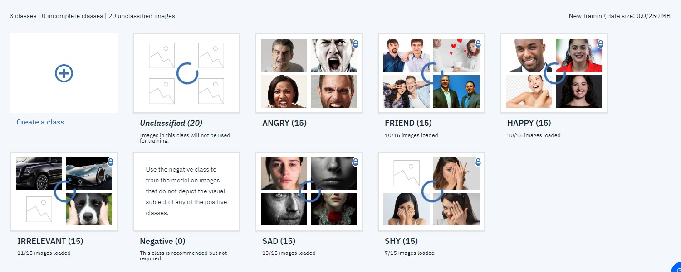
Project Steps
Collecting pictures from the Internet
Creating an IBM Watson account.
Feeding IBM Watson with the data.

Slide 5
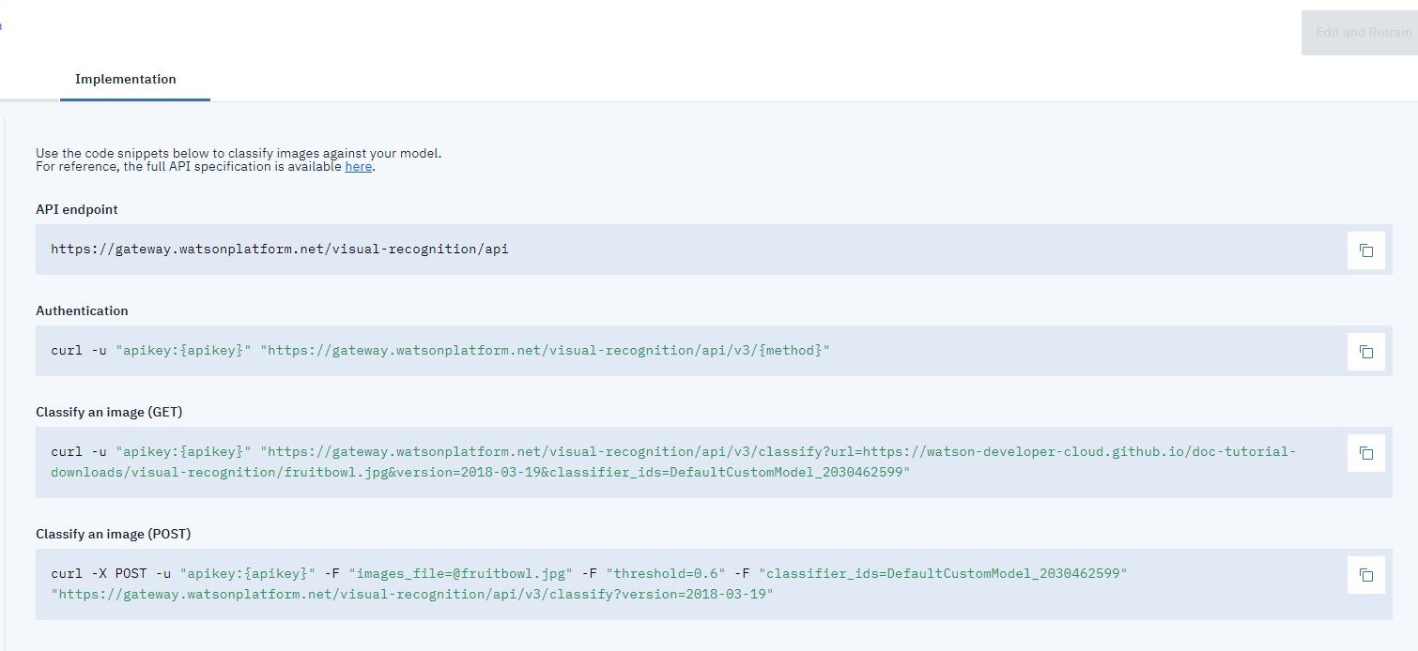
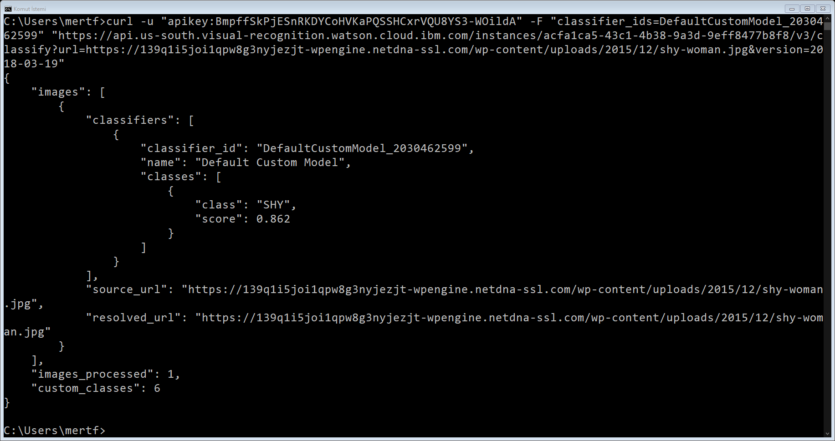
Learning cURL commands and their usage.
Calling the system with cURL commands in Windows.

Slide 6
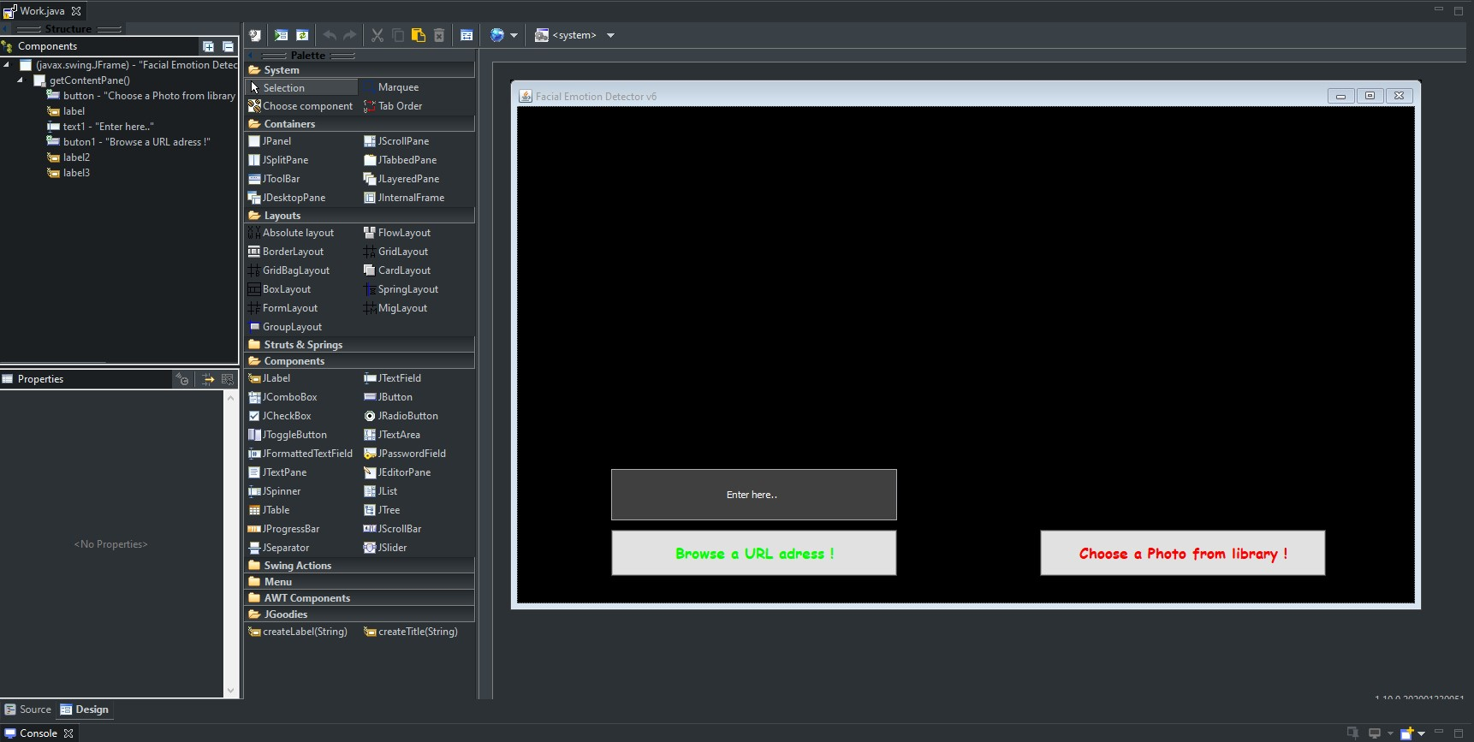
Developing User Interface in Java (Eclipse IDE)

Slide 7
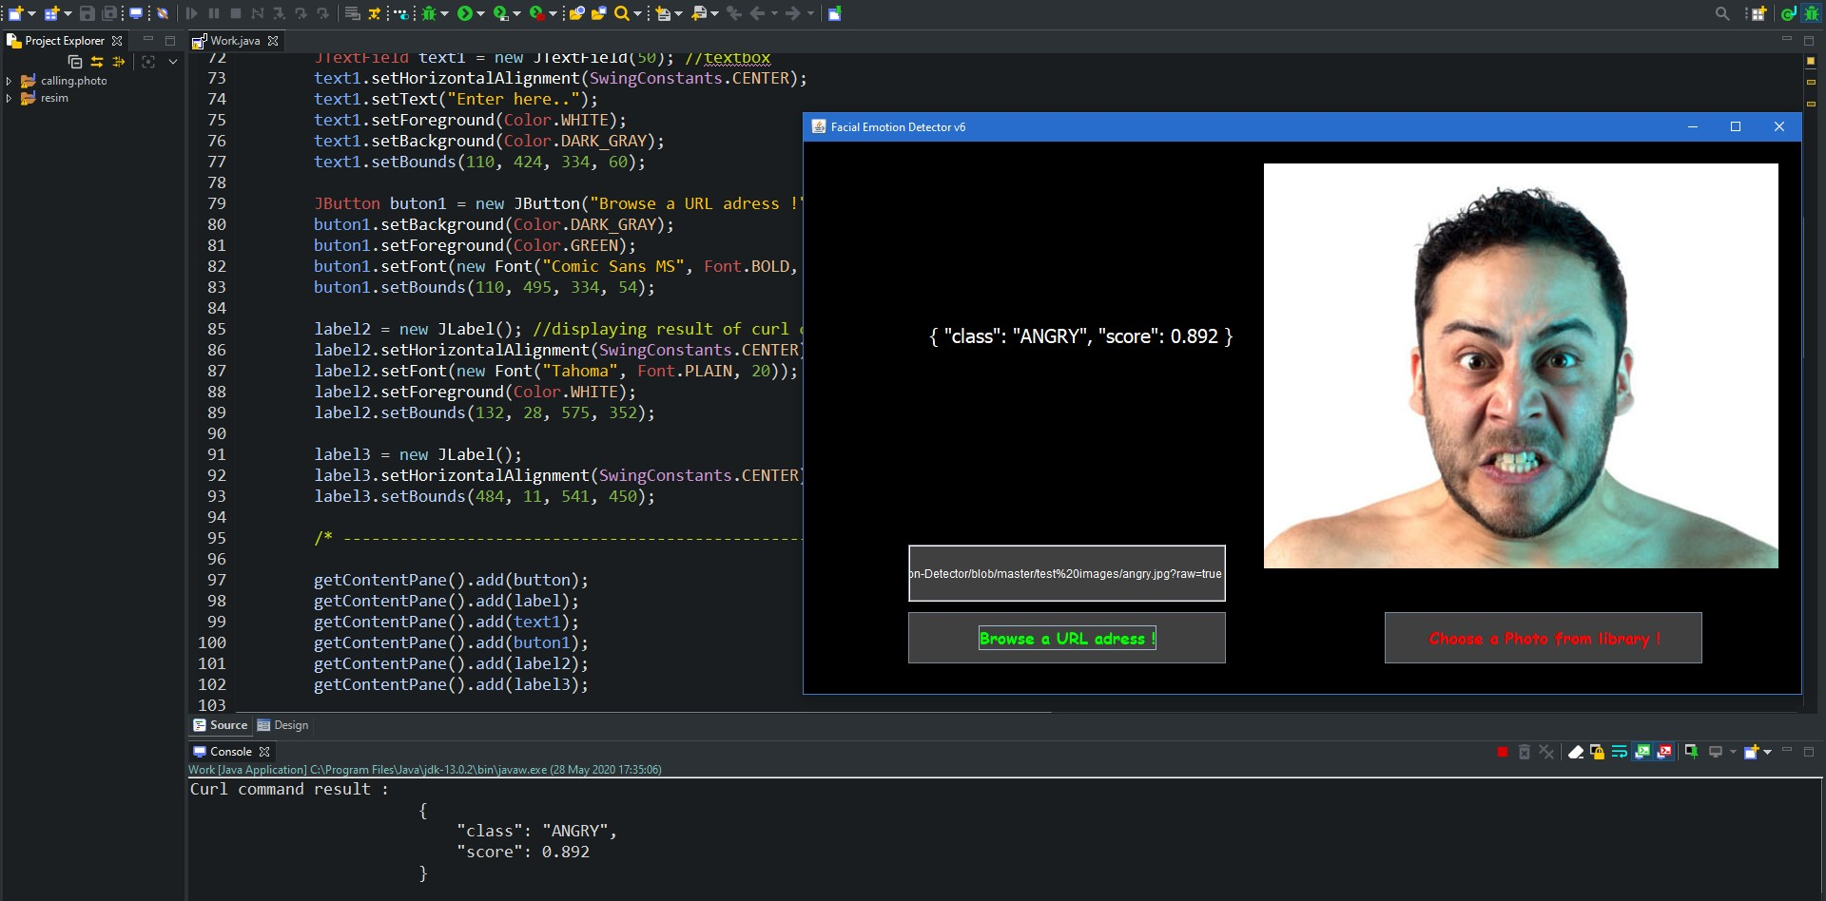
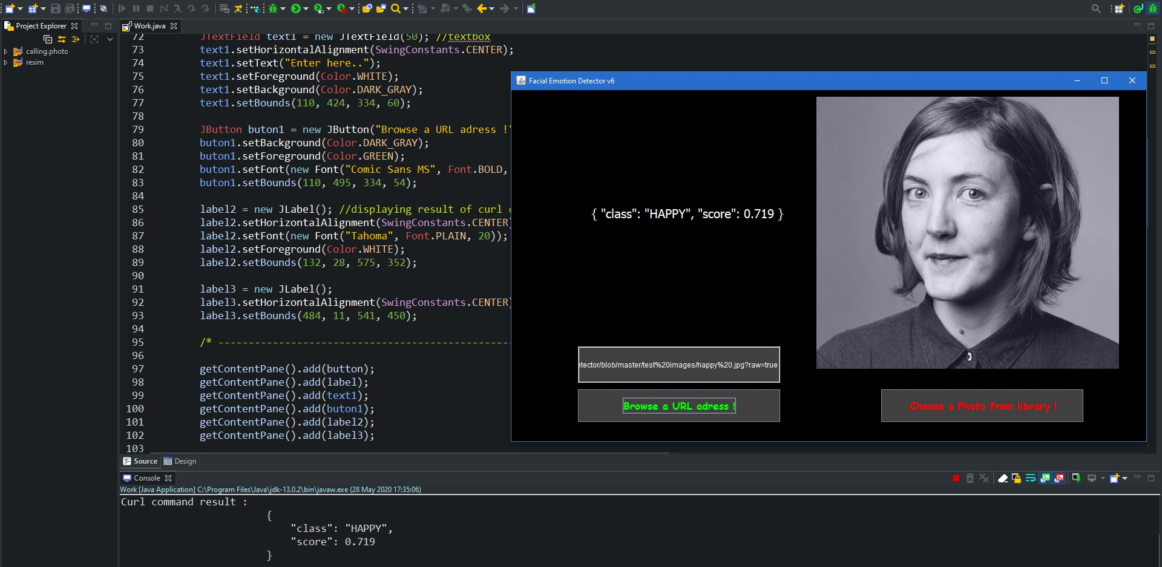
How it Works ?
The user interface is responsible for all process.
Codes are including some conversions;
The URL adress that user entered converting into cURL command, and processed in the background.
The user cannot see the process just can wait to see results.
The result of process is existing in console area of Eclipse. Thanks to some of codes, it can visible on the GUI window. So user find the result in same screen.

Slide 8
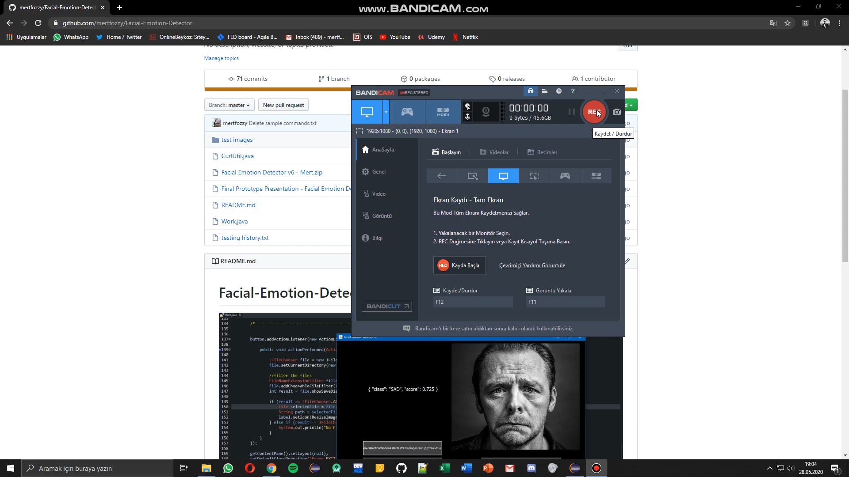
DEMO

Slide 9
https://github.com/mertfozzy/Facial-Emotion-Detector

